Slide 1
General Knowledge
1
Where does Boxing Day get its name from?
Alms box collections
The money collected in church alms-boxes for the poor
2
Which is colder, the North or South Pole?
South Pole
North pole is warmer by about 10 degrees C in summer & 2 C in winter
3
Name as many of Santa’s reindeer as you can – 1 point per name
Dasher, Dancer, Prancer, Vixen, Comet, Cupid, Donner, Blitzen, and Rudolph

Slide 2
General Knowledge
4
On what day are ‘maids a-milking’ mentioned in the song '12 days of Christmas'?
8th
5
1843
What year was the first commercial Christmas card sold in the UK?
By Sir Henry Cole, a British civil servant and inventor: Featuring a family drinking wine, one sold for £8,469 in 2014. 1,000 cards made – 12 survive.
6
Charles Dickens
Who wrote the classic story “A Christmas Carol”?

Slide 3
True or False
1
In 2013 a law was past making it illegal to take misletoe into the house of commons, due to the risk it is seen as sexual harassment
FALSE
2
The film White Christmas used asbestos to create the snow
TRUE
Early films also used: white cornflakes, foamite, salt & flour
3
Xmas pudding used to be a soup-like porridge
TRUE
It was called 'frumenty' until 17th century
4
Mistletoe is an ancient symbol of fertility and virility (aphrodisiac)
TRUE

Slide 4
True or False
5
During WWII a US card company created packs of cards for Xmas, that when wet revealed escape routes
TRUE
Created in conjunction with American & British Intellligence
6
Christmas trees are poisonous
FALSE
Many parts of the Christmas tree can actually be eaten, with the needles being a good source of Vitamin C.
7
The Christmas cracker was originally invented to sell bon-bon sweets
TRUE
1847 London, Tom Smith, sold sweets with a “love motto” inside. He then included a little trinket and a “bang”. His “Bangs of Expectation” included gifts such as jewellery and miniature dolls. By 1900, he was selling 13 million a year.

Slide 5
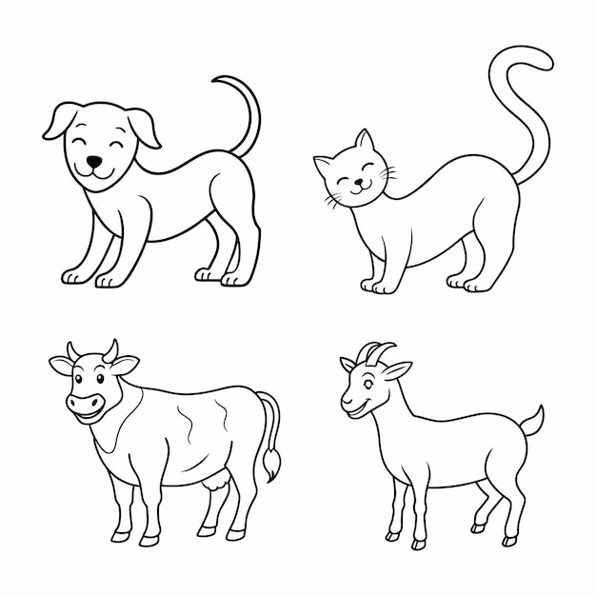
Creatures & Myths
1
The Yule Cat
2
The Yule Goat
In which country are you in danger of being devoured by the Yule Cat at Christmas?
In which country does the invisible spirit Yule Goat appear before Christmas to make sure holiday preparations were done correctly?
ICELAND
SWEDEN, NORWAY, FINLAND,
NORTHERN EURPOEN

Slide 6
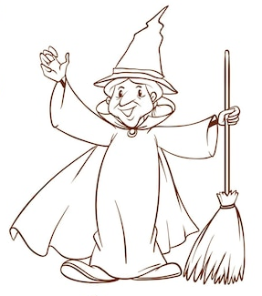
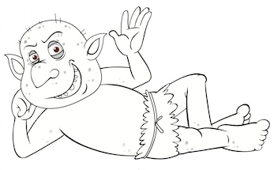
Creatures & Myths
3
Befana
4
Lutins
In which country would you find the Befana (a witch-like old woman) delivering gifts to children on Epiphany Eve (the night of January 5)
In which country would you find these festive hobgoblins?
ITALY, RUSSIA
NORMANDY

Slide 7
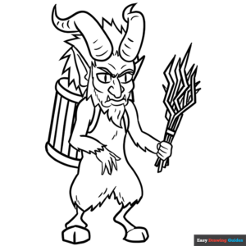
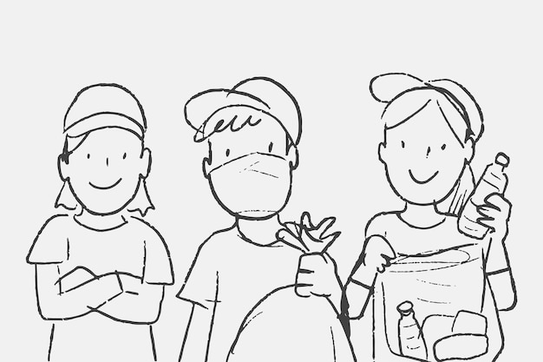
Creatures & Myths
5
Krampus
6
Yule Lads
In which country does Santa’s evil counterpart Krampus punish the naughty children, whilst Santa leaves gifts for the good ones?
In which country would you find the pranksters the Yule Lads?
AUSTRIA
ICELAND

Slide 8
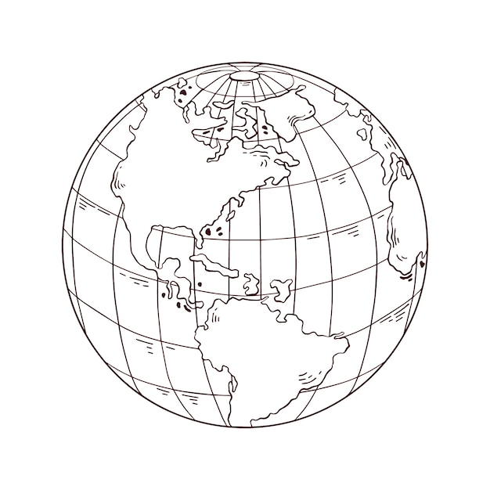

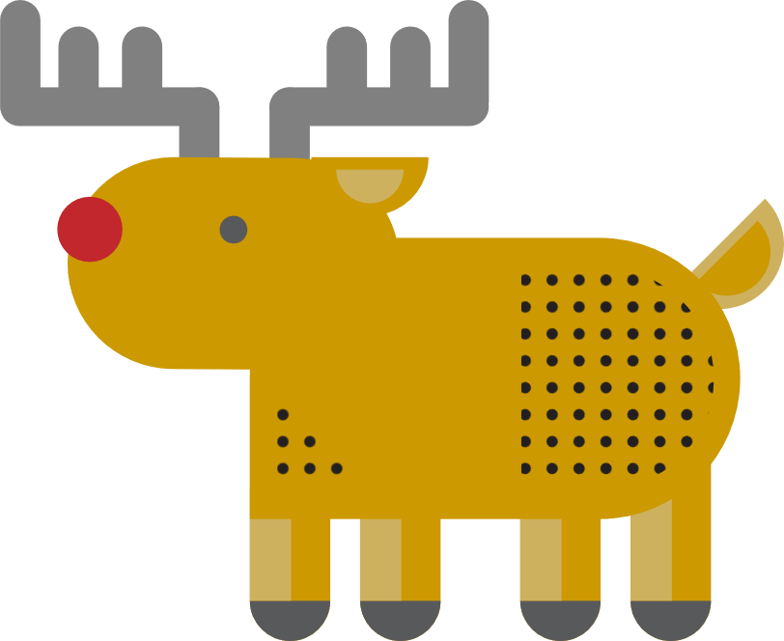



Around the World
1
2
Who is the largest exporter of Christmas trees?
Who has the most reindeer?
More than rest of world combined
RUSSIA
3
4
5
Who gifts a Christmas tree to Britain, placed in Trafalgar Square, for our help during WW11?
Extra point: since which year?
What is the largest Christmas present in world?
Where is the oldest Christmas Market in Europe
Christkindlemarkt - since 1600s
1886
NORWAY
STATUE OF LIBERTY
NUREMBURG
1947

Slide 9
Music
1
What was the xmas number 1 in the year 2000?
Bob the Builder - “We can fix it”
2
What was the first song played in outer space?
Extra point: which year?
Jingle Bells
1965
NASA's Gemini 6A mission
3
True or false: Irving Berlin hated Elvis Presley’s version of “White Christmas” so much he tried to prevent radio stations from playing it
TRUE

Slide 10
Music
Slade
Pogues
Mariah Carey
4
From 1st to 3rd, who earns the most royalties from their Christmas sings?
1st Slade, £500,000, Merry Christmas Everybody; 2nd Pogues, £400,000,Fairytale of New York; 3rd Mariah Carey, £375,000, All I Want For Christmas
Which song had a UK Christmas Singles Chart Number One twice, once in 1975 and again in 1991 (not “Do They Know It’s Christmas”)?
Queen - “Bohemian Rhapsody”
5

Slide 11
Food & Drink
1
In the middle ages, it was tradition for everyone to eat what Christmas treat for each of the 12 days of xmas - bringing good luck for the new year
Mince pie
2
Which is largest, the UK record for biggest Parsnip, Potato or Sprout?
Sprout
Sprout - 8.3kg; Parsnip - 7.88kg; Potato - 4.98kg
3
Which fruit is traditionally put in a Christmas stocking?
Clementine
4
In which country is it now traditional to eat KFC for Christmas dinner?
Japan

Slide 12
Food & Drink
5
Which alcohol is traditionally added to the base of a trifle?
Sherry
6
What type of pudding is asked for in the popular Christmas carol “We wish you a merry Christmas”?
Figgy Pudding
7
What ingredient is traditionally layered under the icing of a Christmas cake?
Marzipan
8
What is the traditional Christmas drink made from eggs, milk and nutmeg?
Eggnogg

Slide 13
Films
1
In Elf, Buddy the Elf anmes the 4 main food groups of his diet – candy, candy canes, candy corns and … what is the fourth?
Syrup
2
What is the name of the Pumpkin King who discovers Christmas Town, in the film "The Nightmare Before Christmas" ?
Jack Skellington
3
Which 1994 Christmas movie features a young boy who receives a magical ticket to the North Pole on Christmas Eve?
The Polar Express
4
In the classic film "It's a Wonderful Life," what is the name of the town where George Bailey lives?
Bedford Falls
5
In "Home Alone," what are the names of the two burglars trying to break into Kevin McCallister's house? 1 point each
Harry and Marv

